Slide 1
Pharmaceutical Classification
By: Omar Obidat and Jesse Parron

Slide 2
Introduction
In this project we utilize Decision Tree modeling and K-Nearest Neighbors to classify the chosen dataset.
The goal of this project is to classify the dataset using the two models and compare the accuracy, confusion matrix, and classification report to see which model performs better in classifying the data. The data should be able to take in a new patient, and thus output the correct pharmaceutical drug the patient should take.
We then utilize cross validation for both models, and three folds validation to validate if the hyperparameters can be further tuned to get better accuracy of the data.

Slide 3
Description of Dataset
Our data set came from Kaggles and it contains the example data for a set of patients. It includes 200 rows and 6 columns.
The data is split to:
Features: patients Age, Sex, Blood Pressure, Cholesterol, Sodium - Potassium levels.
Target: The most suitable drug to take.
Source: https://www.kaggle.com/datasets/pablomgomez21/drugs-a-b-c-x-y-for-decision-trees
Semantics of the columns:
1. Age (Numeric value).
2. Sex (Male or Female).
3. Blood Pressure (HIGH, NORMAL, LOW).
4. Cholesterol (HIGH, NORMAL).
5. Sodium - Potassium (Percentage value ).
6. Drug (drugA, drugB, drugC, drugX, drugY)
We encoded all the data to numerical values for more accurate classification.

Slide 4
Live Demo
Go to Live Demo

Slide 5
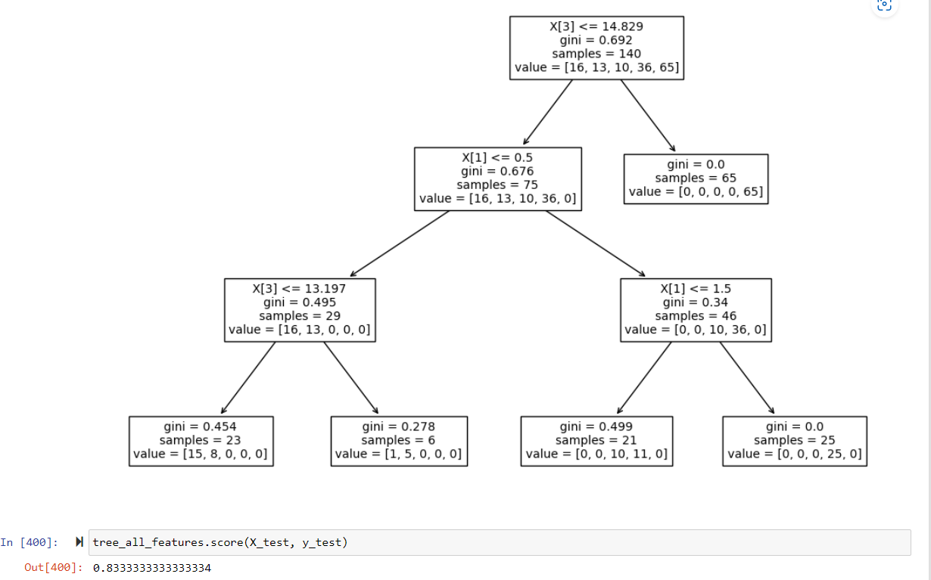
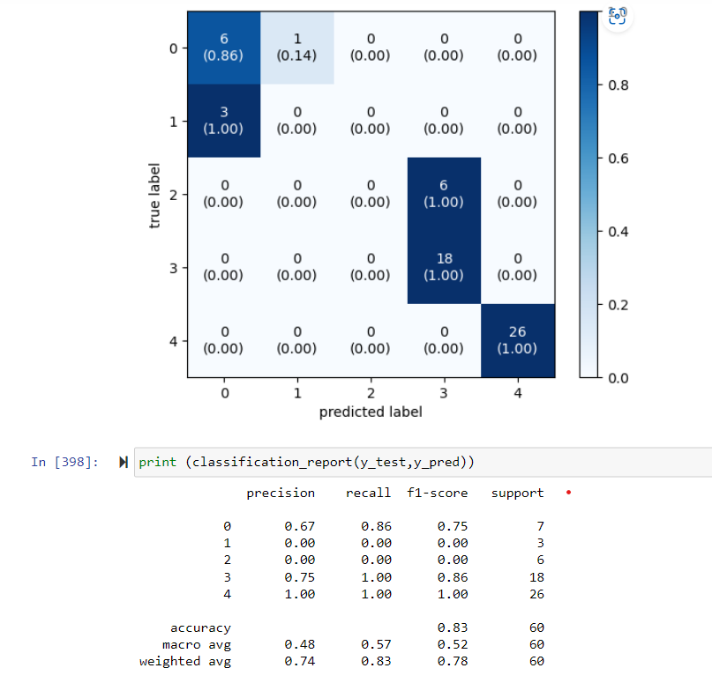
Visualisation - Decision Tree All Features

Slide 6
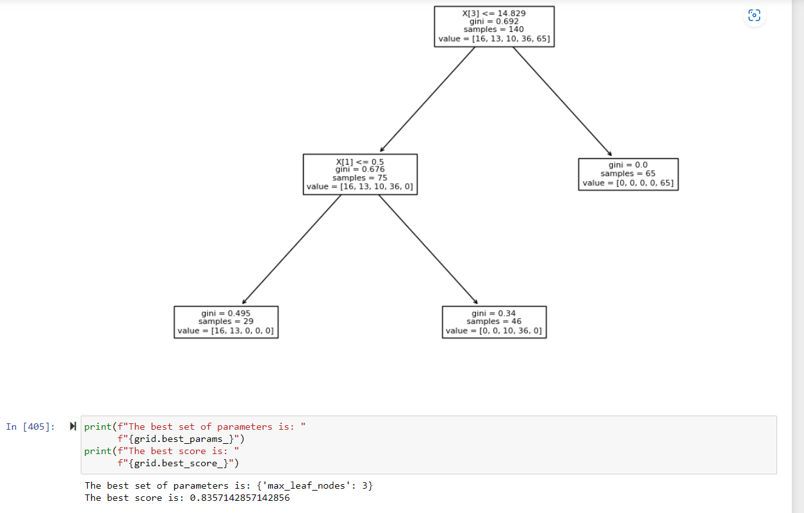
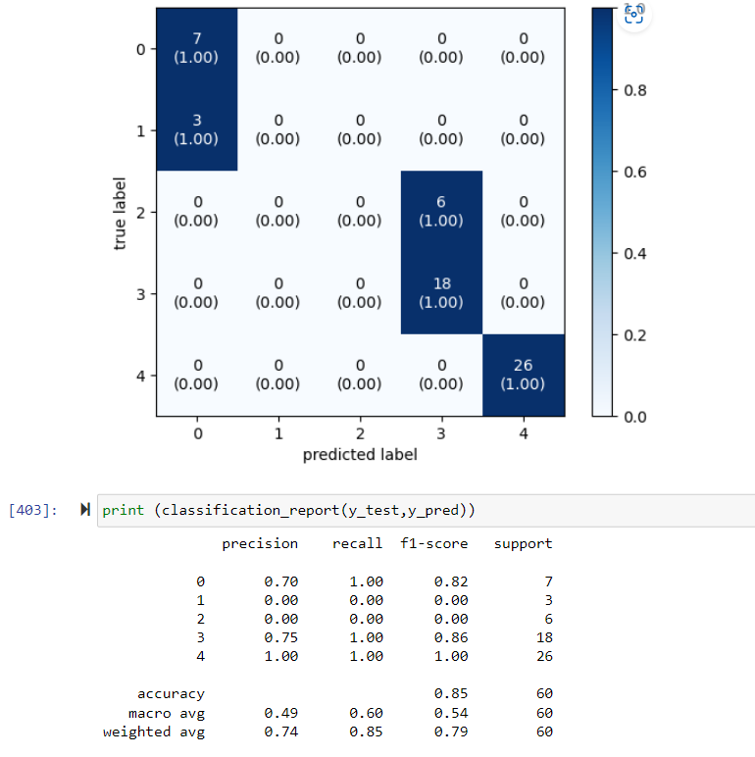
Visualization - Decision Tree All Features of Data After Tuning

Slide 7
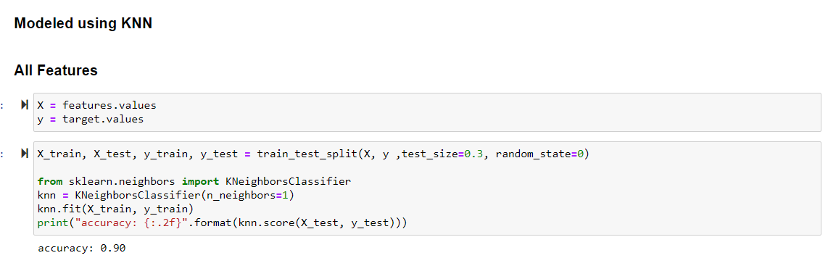
Visualization - KNN All Features

Slide 8
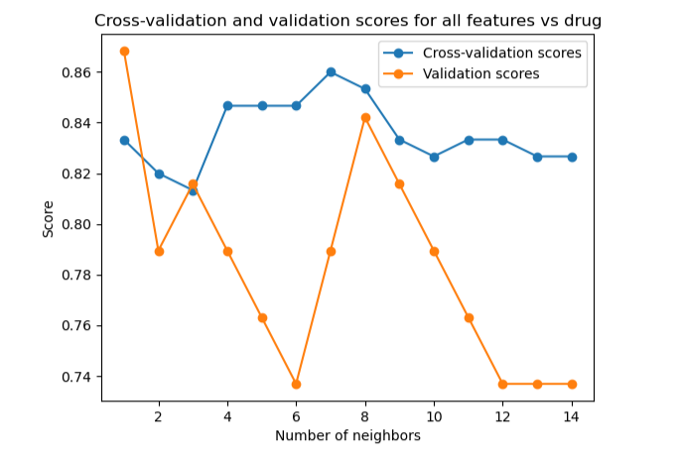


Visualisation - KNN All Features After Tuning
Three Fold Validation Score:
Cross Validation Score:

Slide 9
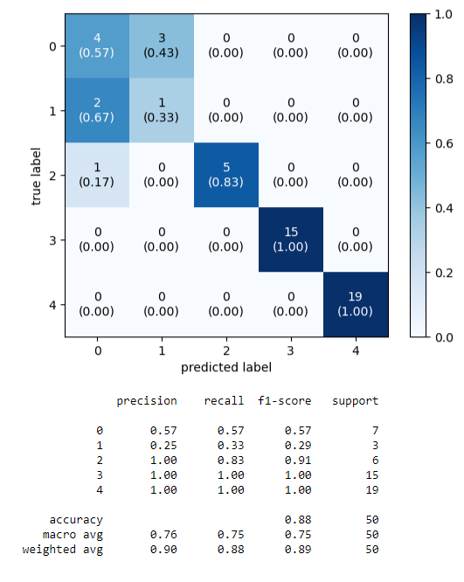
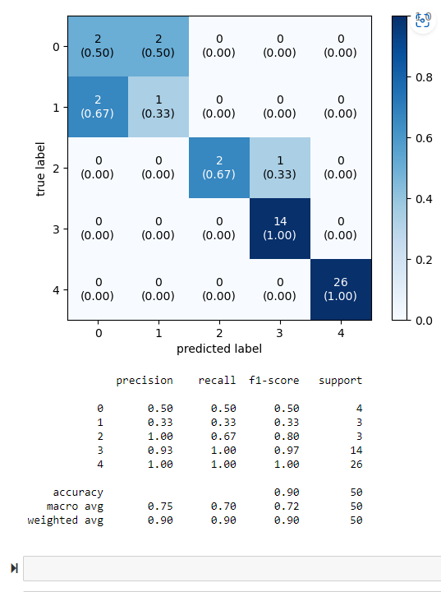
Visualisation - Metrics of Three Fold and Cross Validation
Three Fold Validation
Cross Validation

Slide 10
Conclusion
After analyzing and discussing the Decision Trees and K-Nearest Neighbors models, we can conclude that K-Nearest Neighbors outperformed Decision Trees.
Both models performed exceptionally well, and can be utilized in analysing this form of data. K-Nearest Neighbors just had a slightly higher accuracy score of 90% in comparison to decision trees at 83.5% after tuning.
To go further in detail, we can see that KNN’s cross validation performed the best out of all three accuracy scores as seen in the classification report, the weighted average of the F1, Precision, and Recall scores were 90%. While three folds were: 90%, 88%, and 89%, and Decision Trees were: 74%, 85%, 79%.

Slide 11
THANK YOU

